Slide 1

Visual Studio Code
Utkarsh Gaikwad

Slide 2
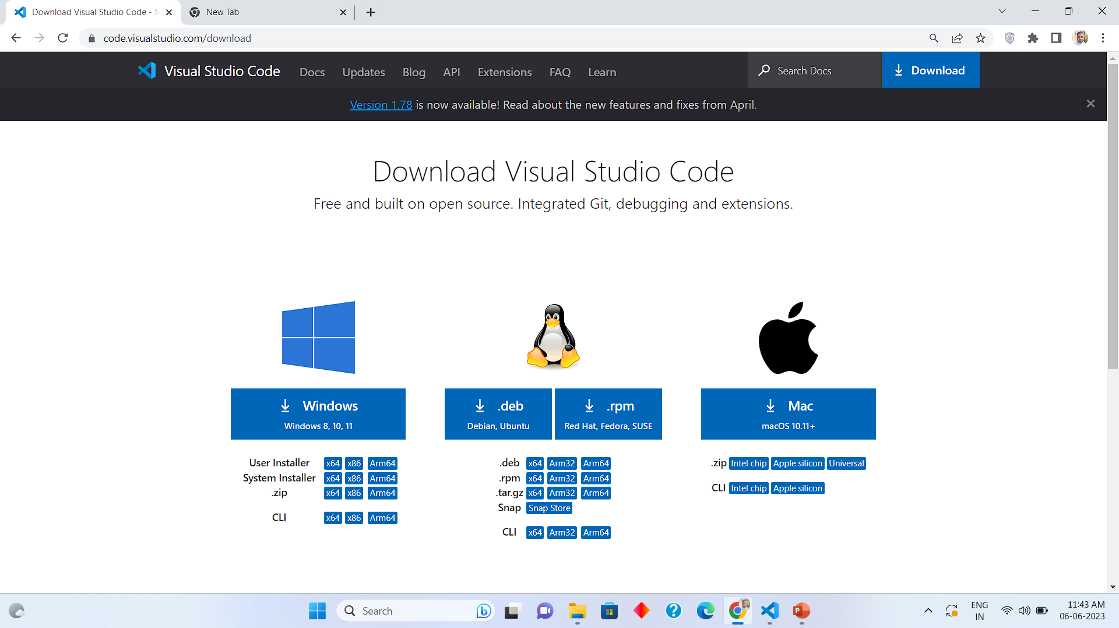
VS Code Website link download
https://code.visualstudio.com/download
Once installation done type done in chat Waiting till 8:15 PM for installation to complete

Slide 3
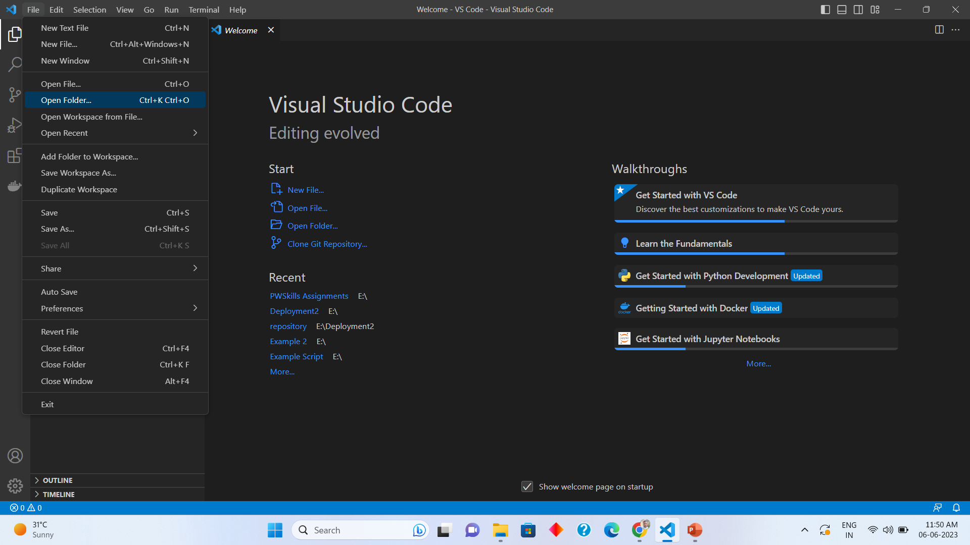
Opening New Folder in VS Code
File > Open Folder

Slide 4
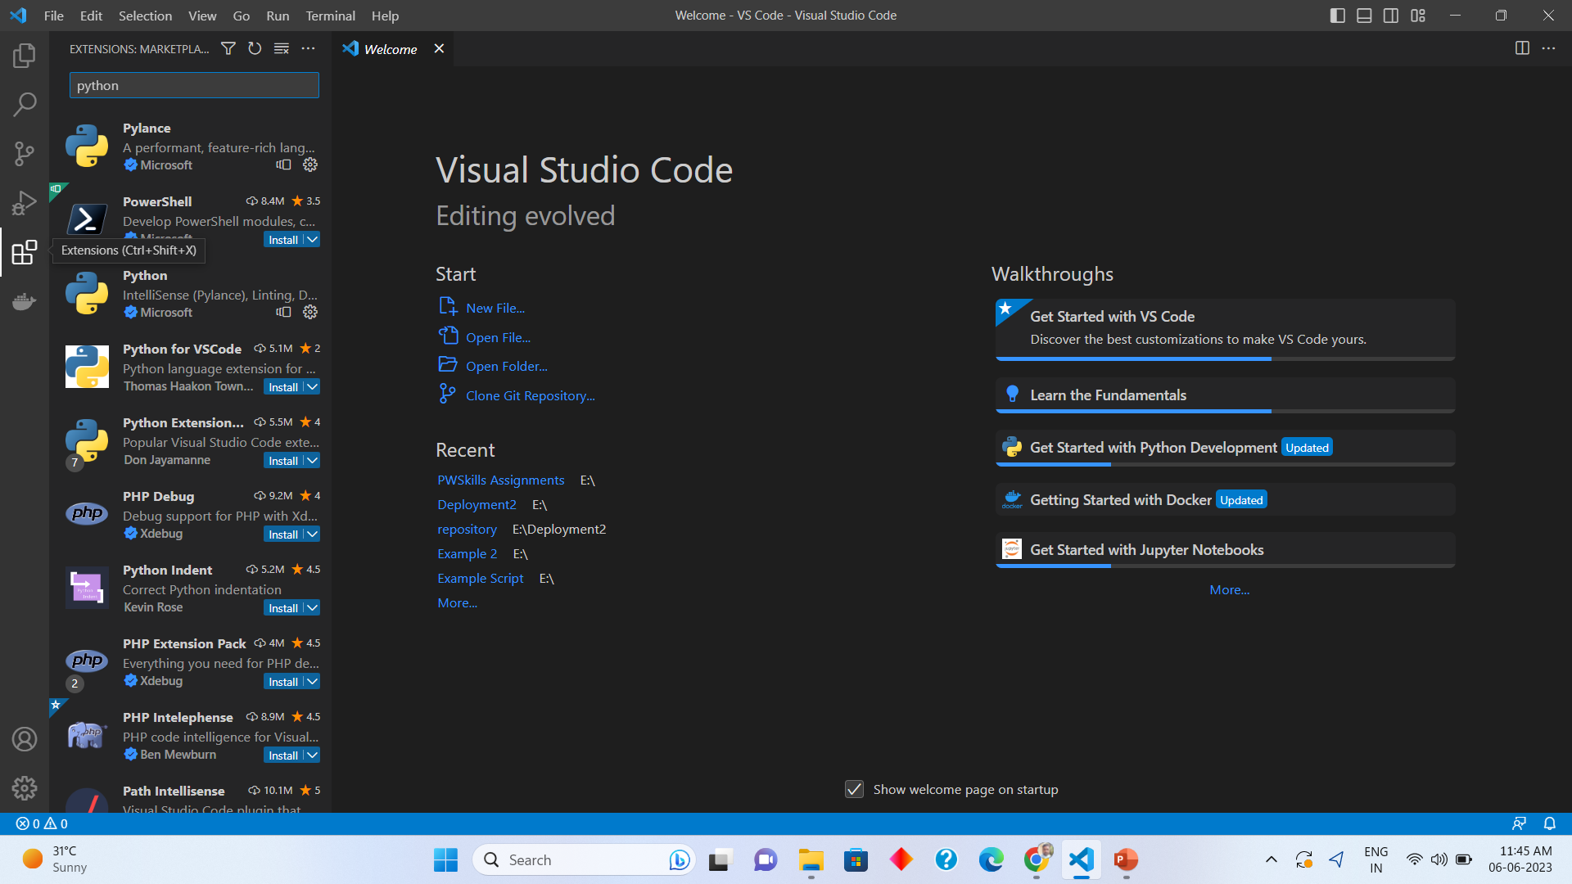
Installing Python Extension in VS Code
Step 2:
Search Python
Step 1:
Extensions
Step 3:
Install Python
Extension

Slide 5
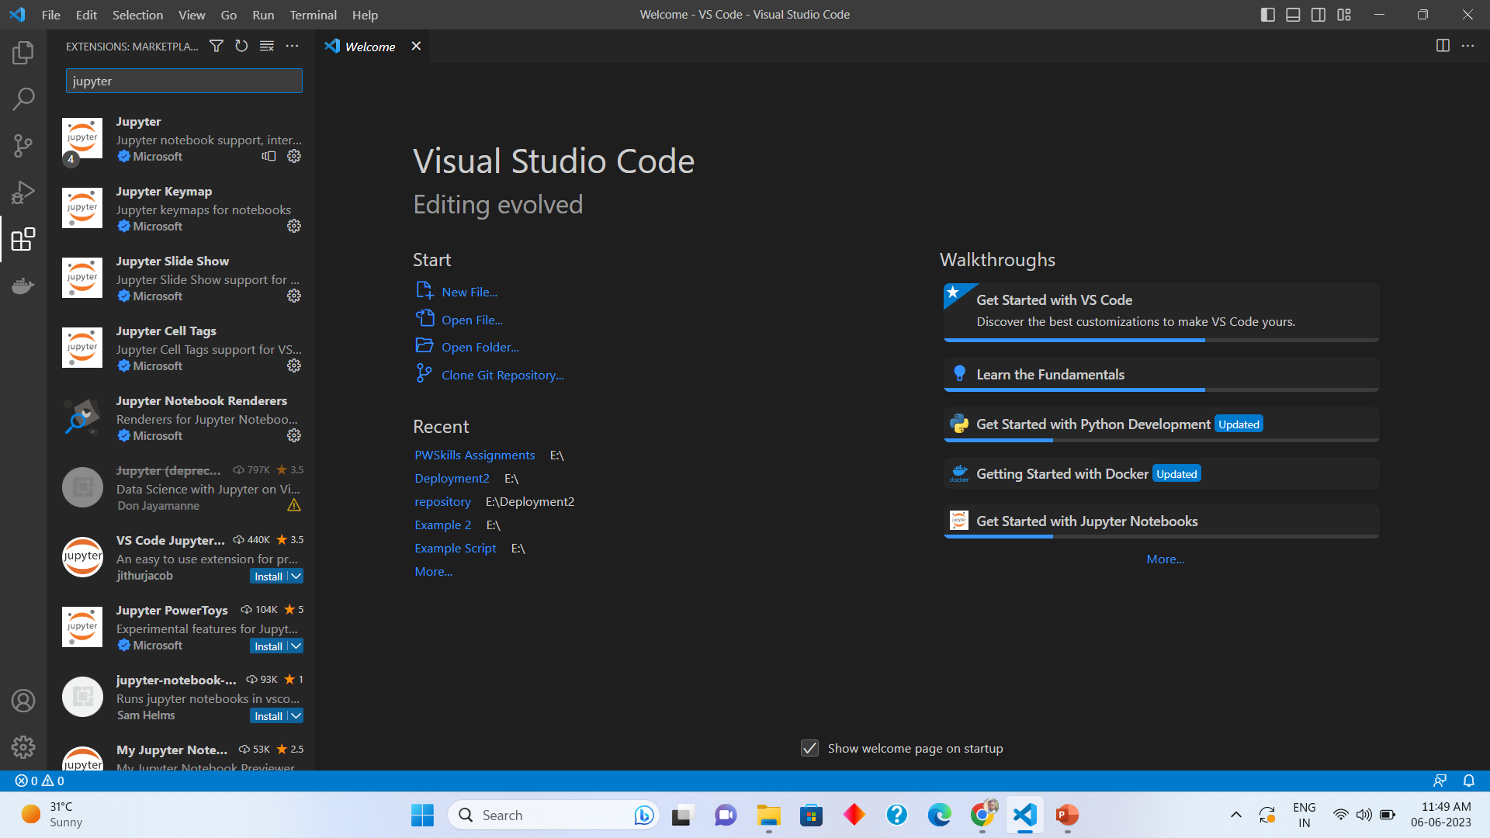
Installing Jupyter notebook extension
Jupyter
Extension

Slide 6
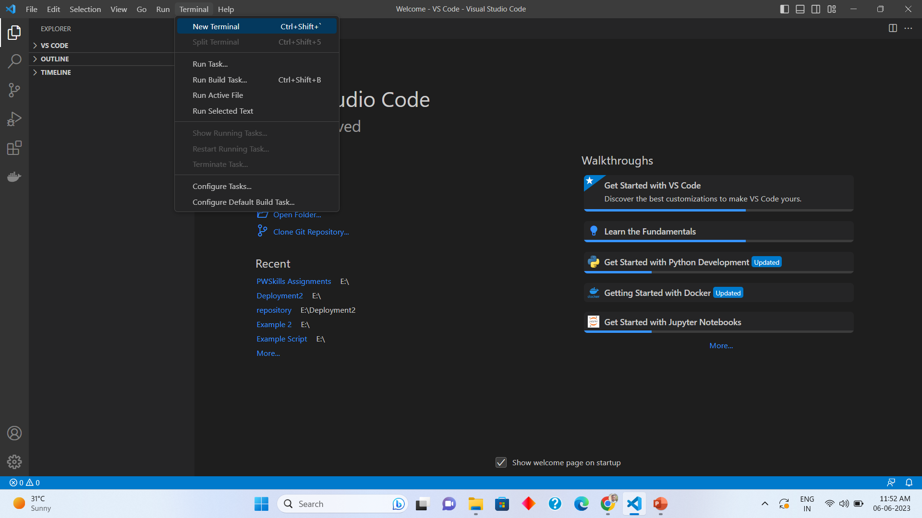
Opening New terminal in VS Code

Slide 7
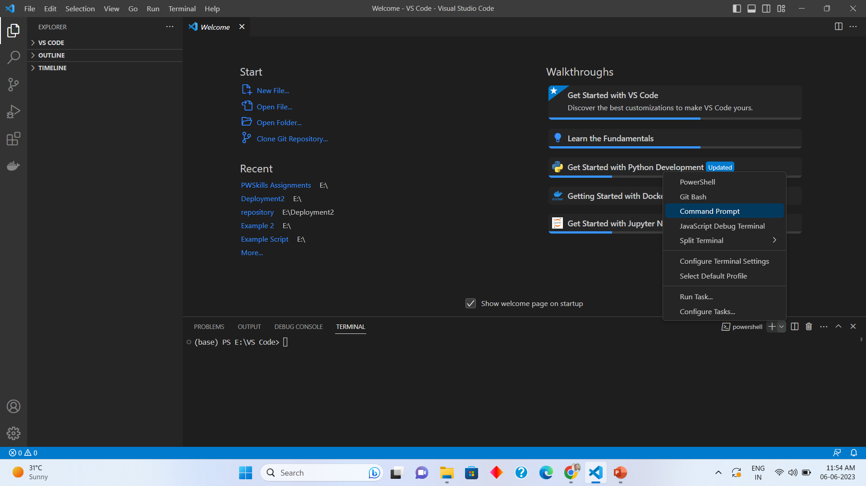
Open Command Prompt in terminal
Select Command
Prompt
Press Down
Button here

Slide 8
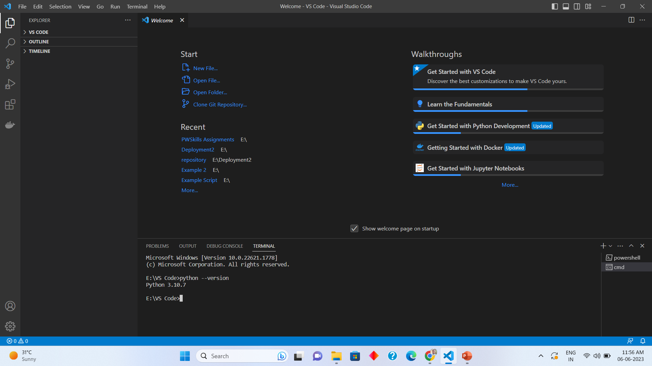
Python version check
python --version

Slide 9
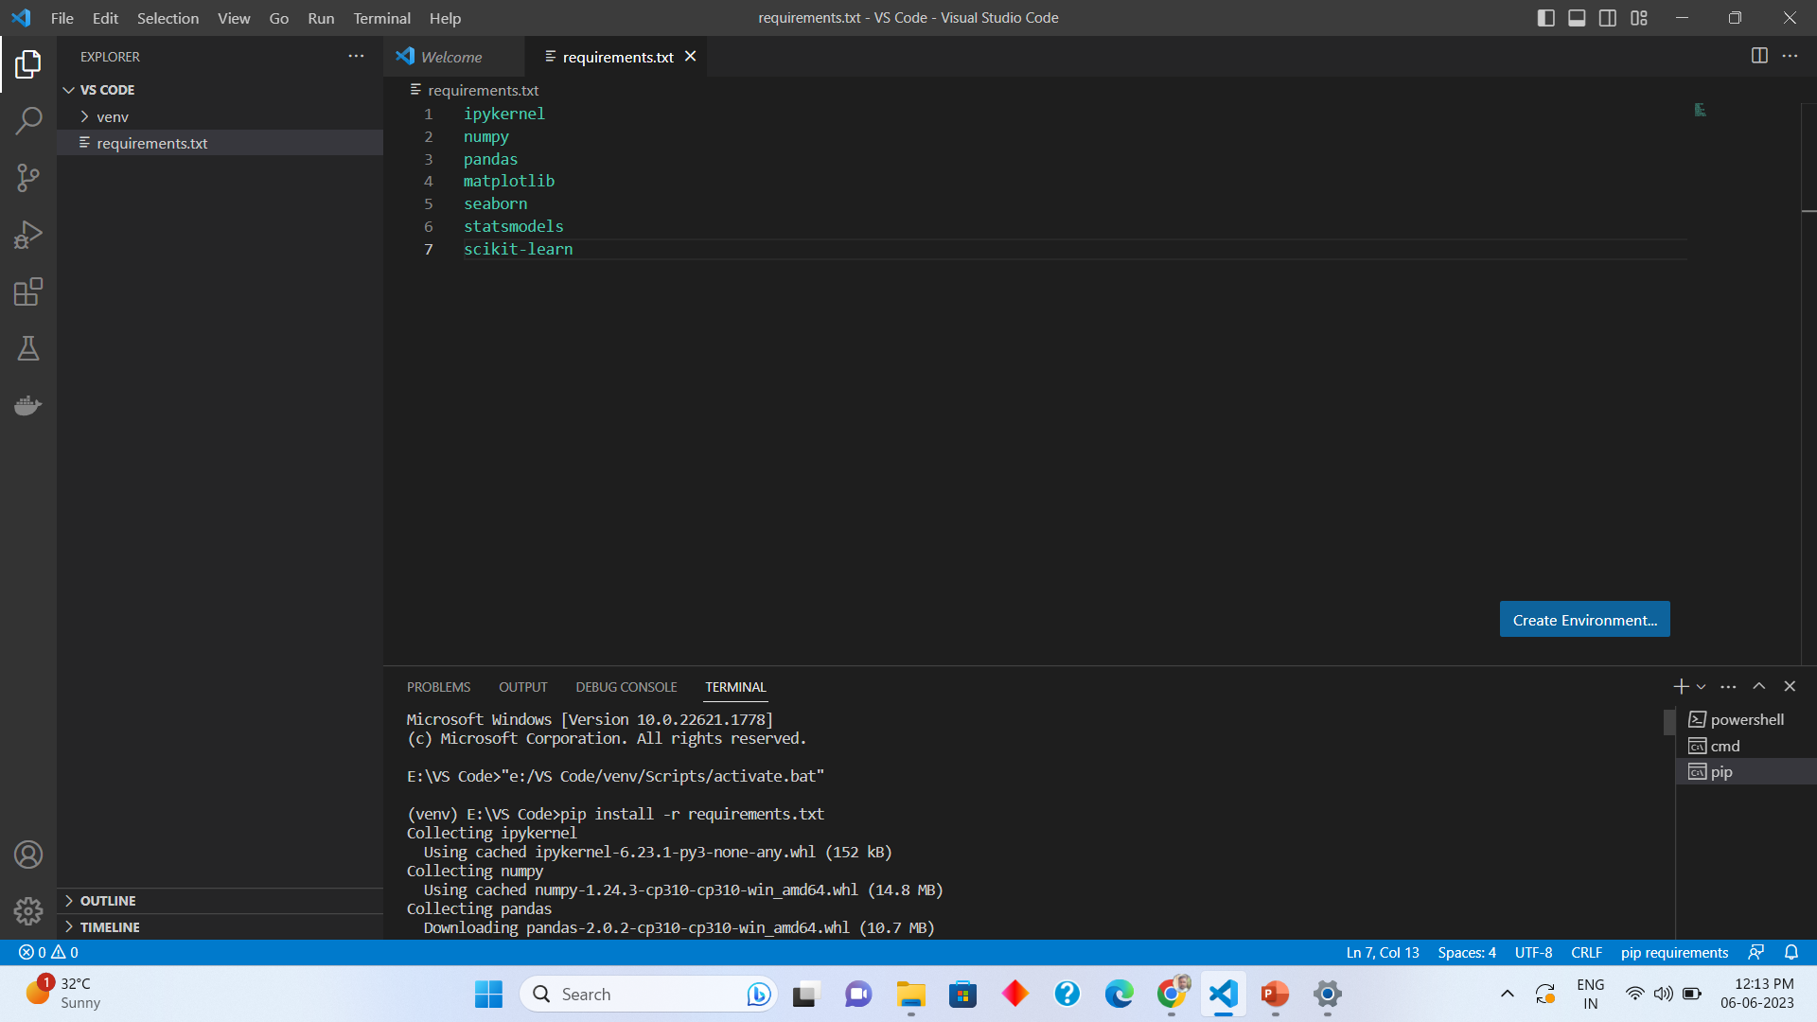
Installing requirements.txt
1. Python –m pip install --upgrade pip
2. pip install -r requirements.txt

Slide 10
Thank you
Ping me on skype for any queries
Once completed you can leave for the day

